Slide 1
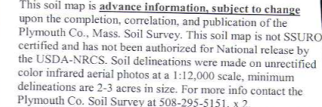
Plymouth County Soil Survey Update (Extensive Revision 1990-2010)
It’s Done!
Notes:
Slide show used at the Last Acre Ceremony for Plymouth County, MA.

Slide 2
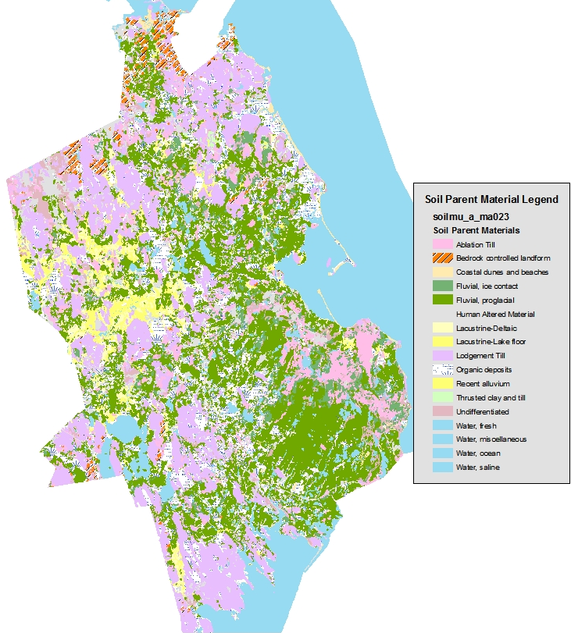
Plymouth County Soil Survey
Size: 425,000 acres
MLRA’s: 149B & 144A
Scale: 1:12,000
Minimum Size Delineation. 1/2 acre
34,354 soil polygons
8,656 Special spot features
Notes:
General Info about Plymouth County

Slide 3
What’s the Difference
1969 Plymouth
2010 Plymouth
Scale 1:15,840 (MSD~2.5)
Gloucester Soil acreage = 35,550
Field work 1950-1963
Pre-taxonomy, soils described to shallow depths (30” in some)
Sb = Sanded muck / bog
Urban areas unclassified
28 series recognized
106 mapunits
No coastal/tidal marsh soils
Scale 1:12,000 (MSD~0.5)
Gloucester Soil Acres = 2,875
Field work 1989-2009
Soil Series names on cranberry beds
Urban areas classified as high as possible to series
6 New Soil Series, 9 Dropped, 52 series in all. Classified to 65 inches.
Georeferenced sites
231 mapunits
Tidal series, dune soils, and beach units established.
Notes:
Comparison of 1969 to 2010 survey.

Slide 4
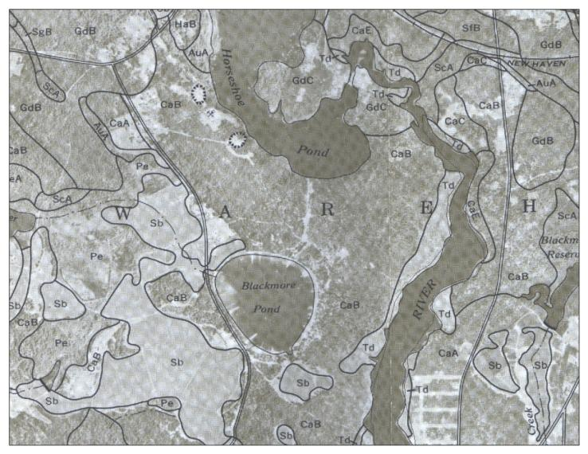
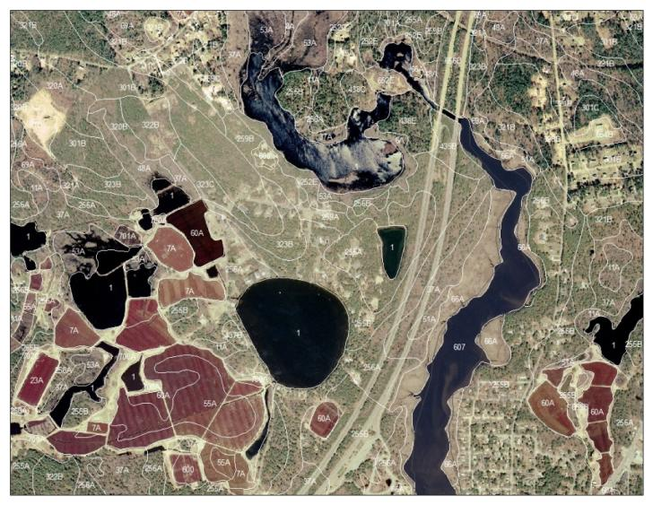
Comparison
1969 Survey
2010 Survey
Notes:
Comparison of the 1969 and 2010 soil maps

Slide 5
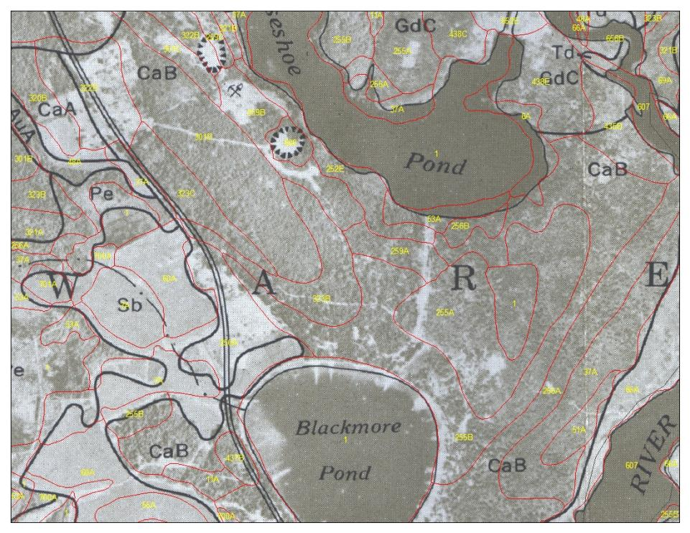
1969 with 2010 in Red
Notes:
An area of the 1969 soil map with the 2010 mapping overlaid in red.

Slide 6
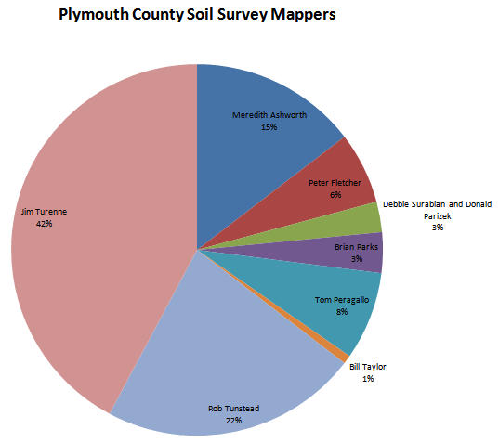
The Plymouth Mappers
Pete Fletcher* 1989 to 1992+
Jim Turenne 1990 to 2003
Meredith Ashworth 1994 to 1999
Rob Tunstead 2000 to 2010
Brian Parks 1997 to 2009
Tom Peragallo 1991 to 2008
William Taylor 1990 to 1995
Donald and Debbie 2008 to 2010
Other Mappers: Terry Schnider, Brian Lesinski, Phil Angel, volunteers and interns.
Thanks to All!
*Pete’s acres mainly on the dunes and beaches!
Notes:
Breakdown of the mappers.

Slide 7
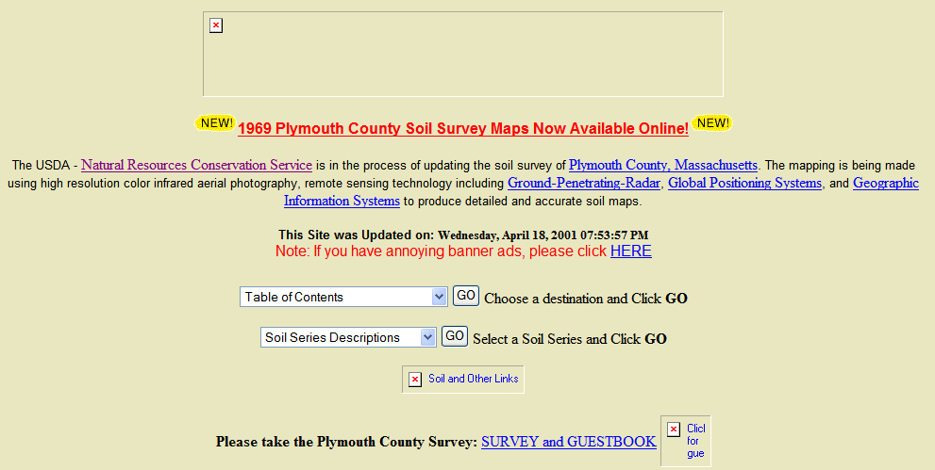

The Website
Started 1996, one of the first soil survey WebPages. Provided update data, farmland lists, series info, data, soil description database, geophysical info
Over 2 million hits since inception – now nesoil.com
Notes:
The first website set up in 1996.

Slide 8
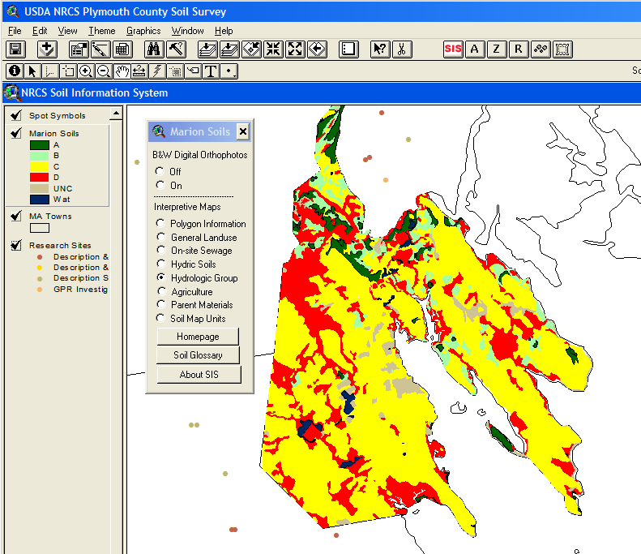
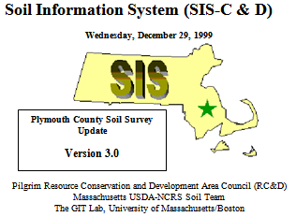
SIS (Soil Information System)
Developed in 1998 with RC&D one of first GIS projects to provide soil interpretive data using the updated mapping. Hundreds of copies of the CD sent out.
Notes:
Soil Information System for Rochester and Marion MA. 1998

Slide 9
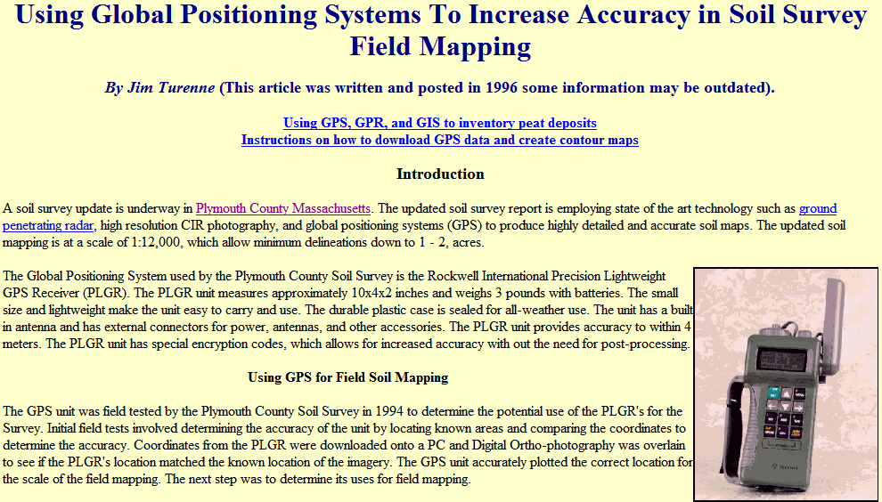
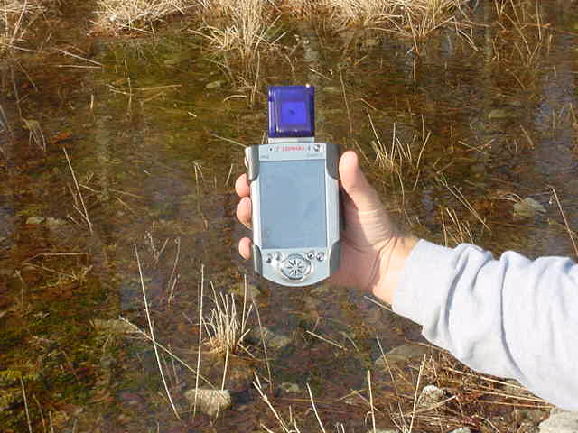
GPS and GIS in Field
Notes:
GPS and field PDAs used in 1994 to geo-locate all data collected.

Slide 10
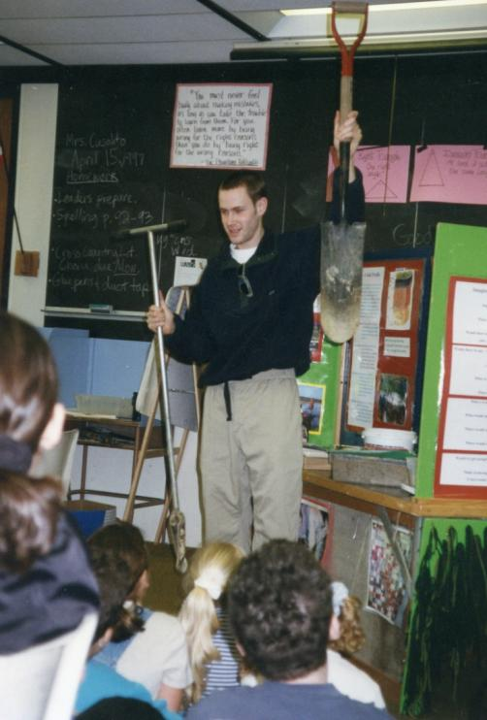
The (Original)Soil Tunnel (aka Wormhole)
Developed by two volunteers from U.K (Nicky Shirt and Michael Bonner. Educational display taken to schools to teach about soils, curriculum written and interns trained. Featured at the National Mall in Washington DC.
Notes:
The educational soil tunnel (a.k.a. the wormhole) was developed in Plymouth and traveled to schools to teach kids about soil.

Slide 11
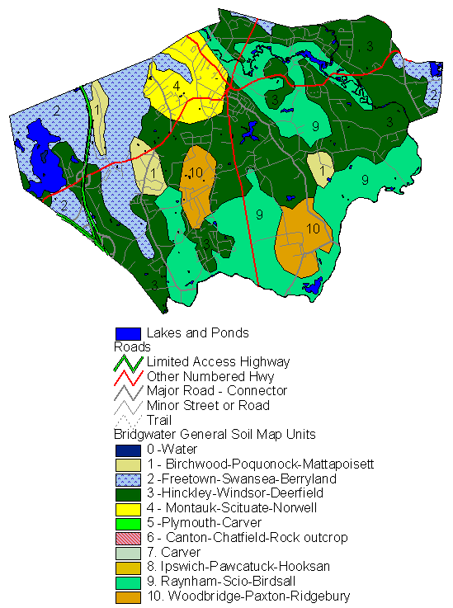
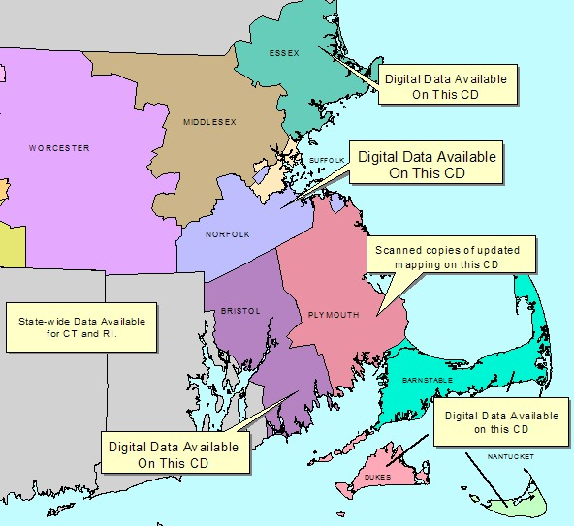
Digital Products
Soil CD with digital maps and attribute info, General soil maps for towns, catena charts, scanned atlas sheets, soil interp data.
Notes:
Some digital products produced using ArcView 2.0!

Slide 12
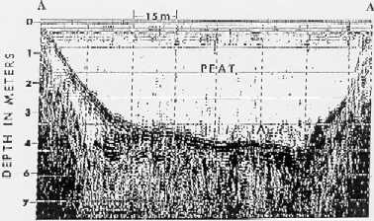
Plymouth County Soil Scientist Technical Assistance
Ground Penetrating Radar Investigations
Water Table Monitoring Well Program
Title 5 Workshops
Farm Bill Technical Assistance 9 County Area
Rapid Carbon Assessment (RaCA)
ERT Technical Assistance
Hydric Soil Workshops
New England Hydric Soils Technical Committee (NEHSTC)
Basic Soil Services

Slide 13
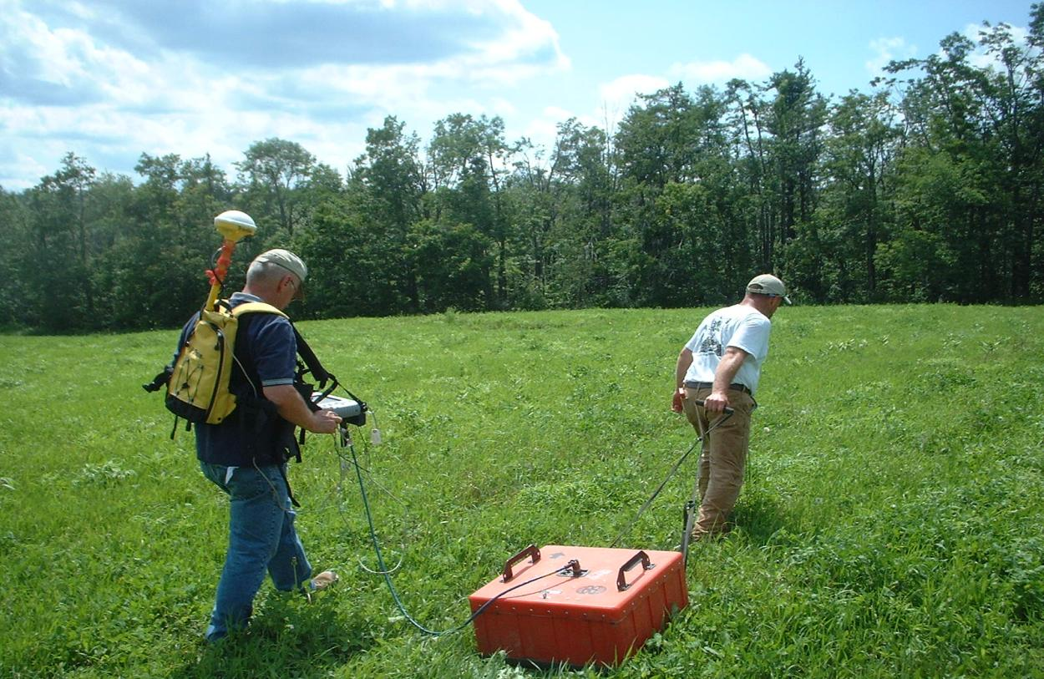
New Technologies
GPR with integrated GPS Capability

Slide 14
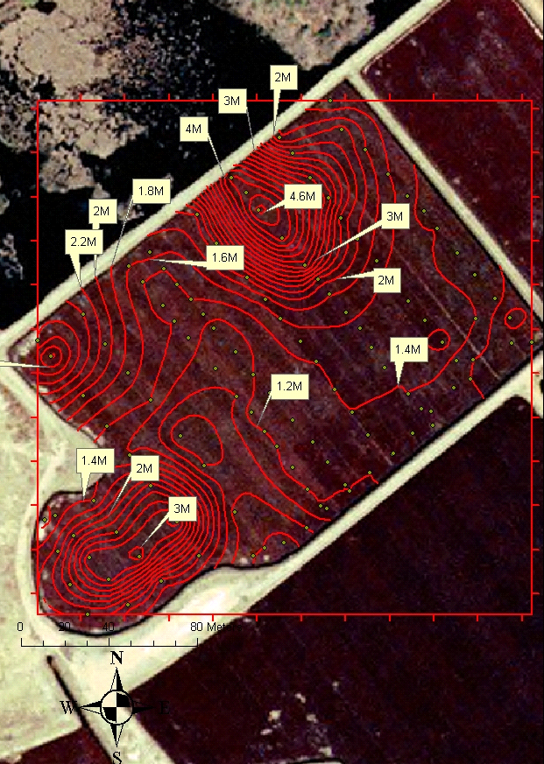
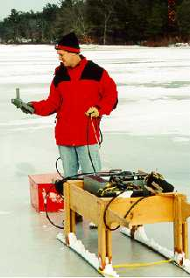
GPR - 2D - Peat Thickness (http://nesoil.com/gpr/gprgis.htm)
Procedure developed to utilize GPS and GIS to provide detailed maps of peat thickness in bogs.

Slide 15
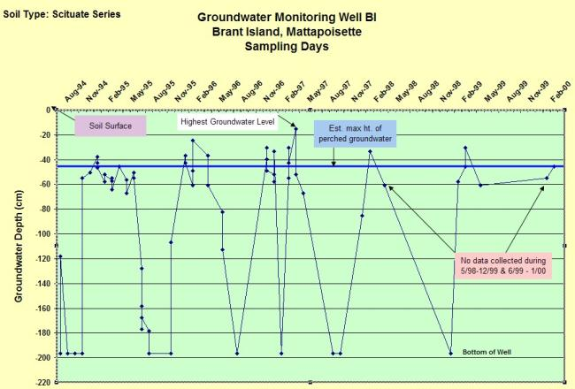
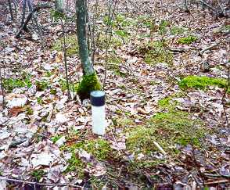
Southeastern Massachusetts Index Monitoring Well Network http://nesoil.com/obswell/index.htm
Network of over 38 well sites setup in SE Mass.
Town request (Board of Health Officers) / Watershed Groups
Assist w/ new Soil Series definition and NASIS data population
Data confirms and assists with revisions of established Soil Series definitions
Info used in Hydric Soil Identification (National & Regional Keys)

Slide 16
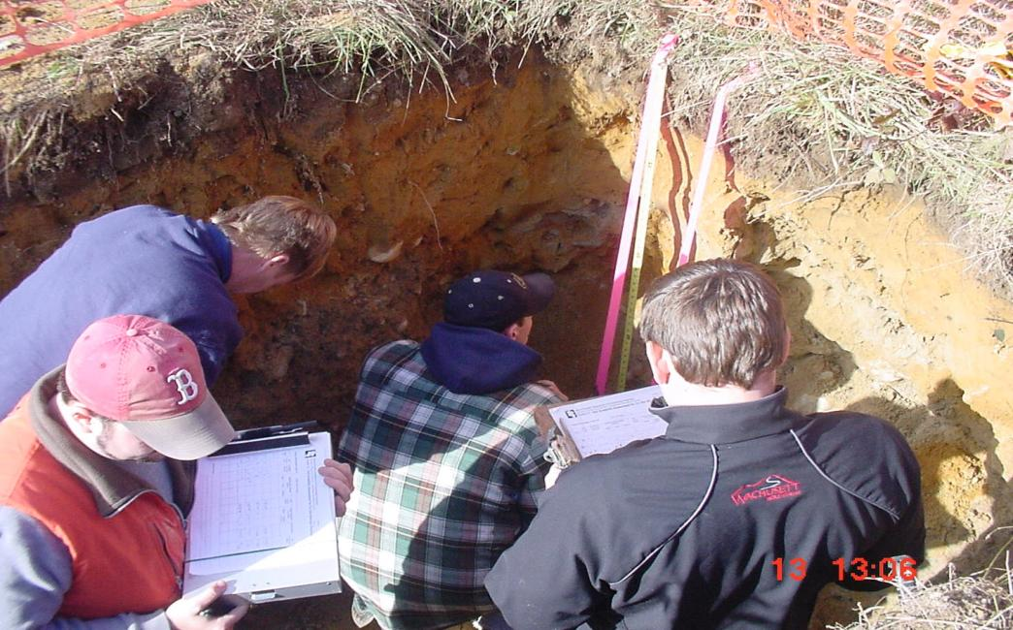
Title 5 - Soil Evaluator Workshops
Began in 1994 and continued through current. Sessions eductated professionals on soil evaluation for septic system siting. Money went to District to hire contract mappers to accelerate the survey.

Slide 17
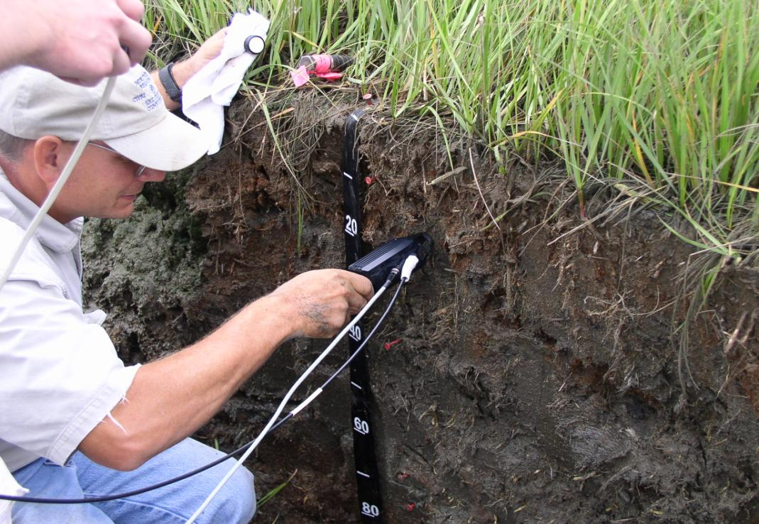
Rapid Carbon Assessment (RaCA)
Current National Initiative to determine soil organic carbon content. Assessment uses a spectrometer to analyze the soil samples collected.

Slide 18
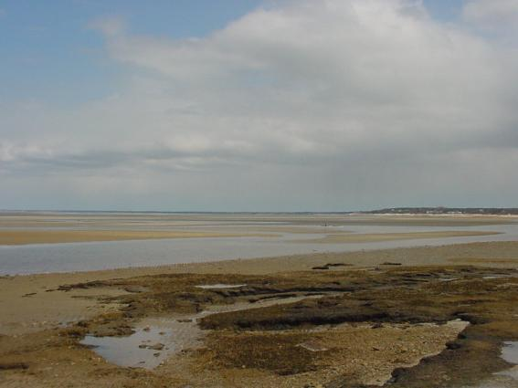
Environmental Review Team (ERT)
Purpose – Provide local officials, boards, and commissions with accurate natural resource information and interpretations to make wise land use decisions
Project Areas:
Quivet Neck, Dennis
Viall Farm, Rehoboth
Cole Property, Carver
Tidal flats at Quivet Neck, Dennis

Slide 19
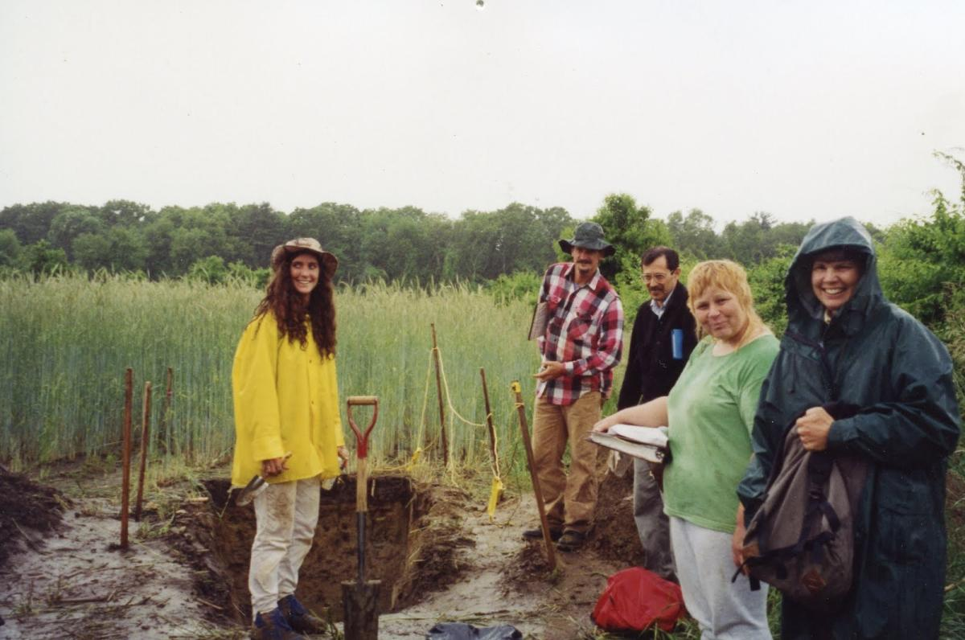
Hydric Soil Workshops
The Workshop from hell – Barnstable MA.

Slide 20
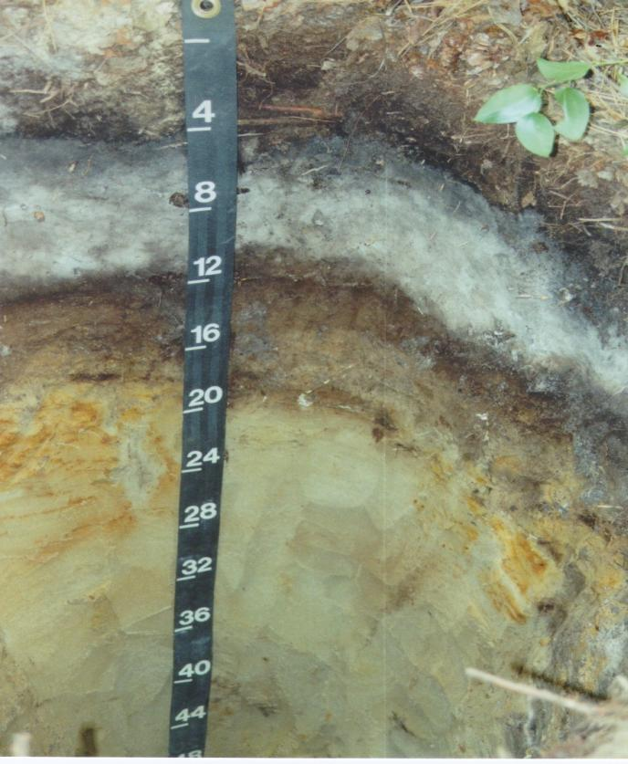
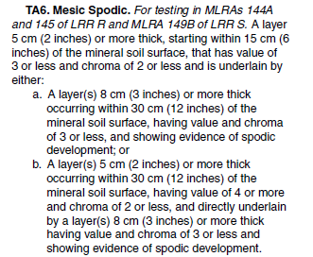
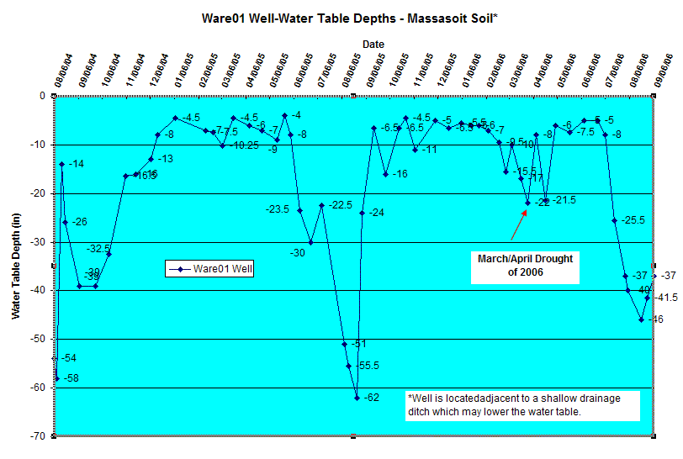
New England Hydric Soils Technical Committee (NEHSTC)

Slide 21
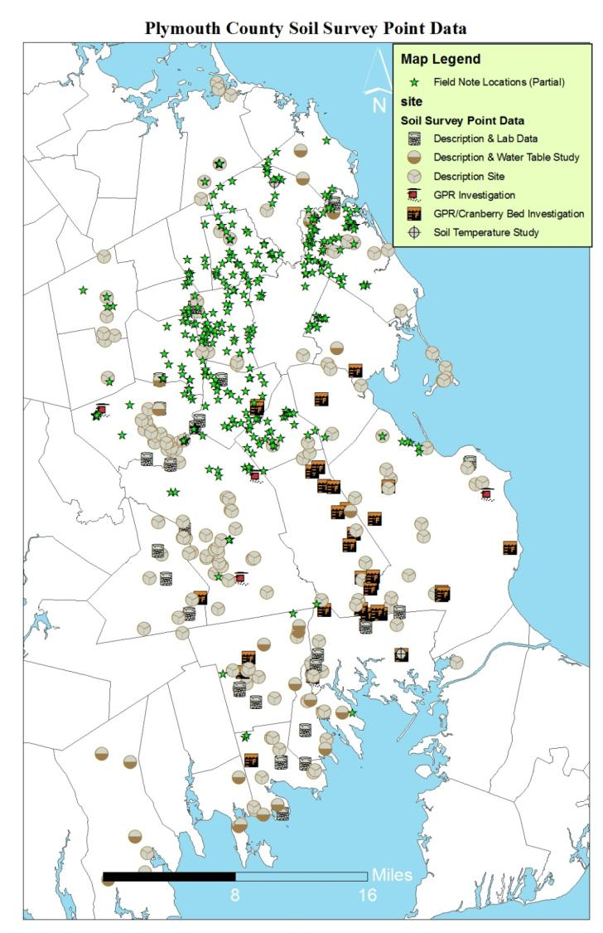
Geo-referenced Site and Field Notes
All data collected during the survey has been geo-located and the point data made available to users via WWW (Google Earth). Data includes pedon descriptions, lab sampling data, water table and climate sites, GPR investigations, field notes.

Slide 22
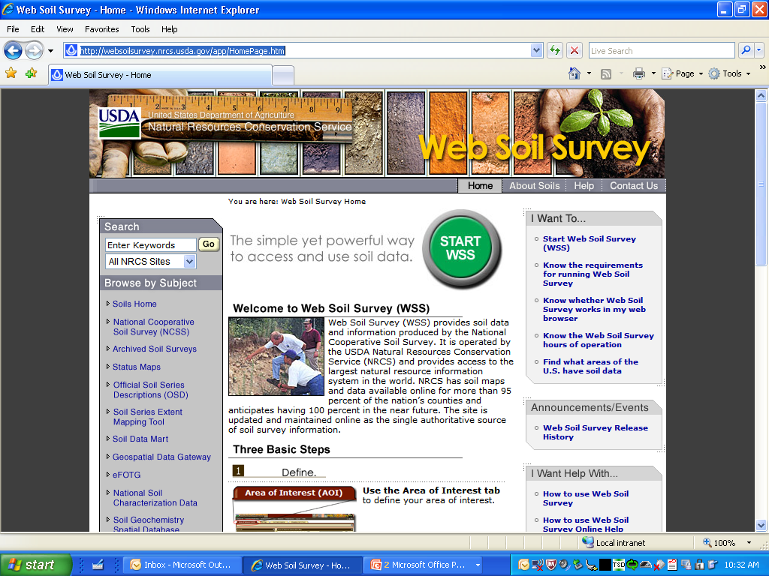
Web Soil Survey
(http://websoilsurvey.nrcs.usda.gov
Also: http://www.mass.gov/mgis/massgis.htm

Slide 23
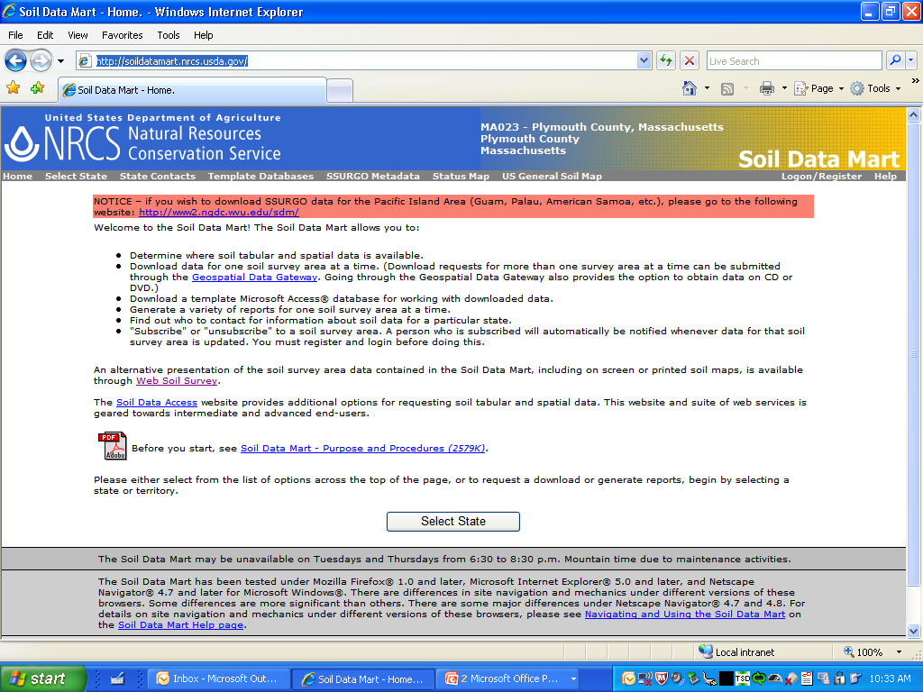
Soil Data Mart (http://soildatamart.nrcs.usda.gov/)

Slide 24
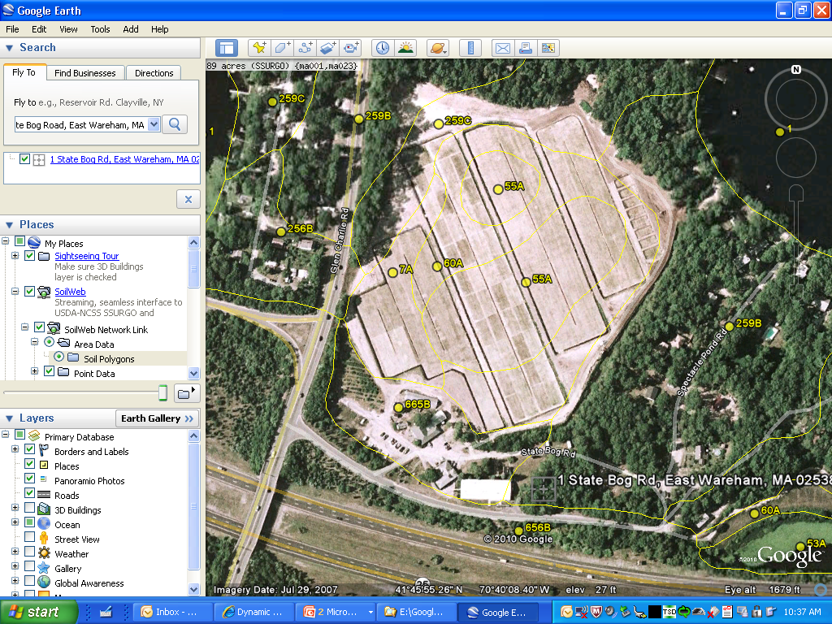
Google Earth Soils Information (http://casoilresource.lawr.ucdavis.edu/drupal/node/429) Also available on Smart-Phones

Slide 25
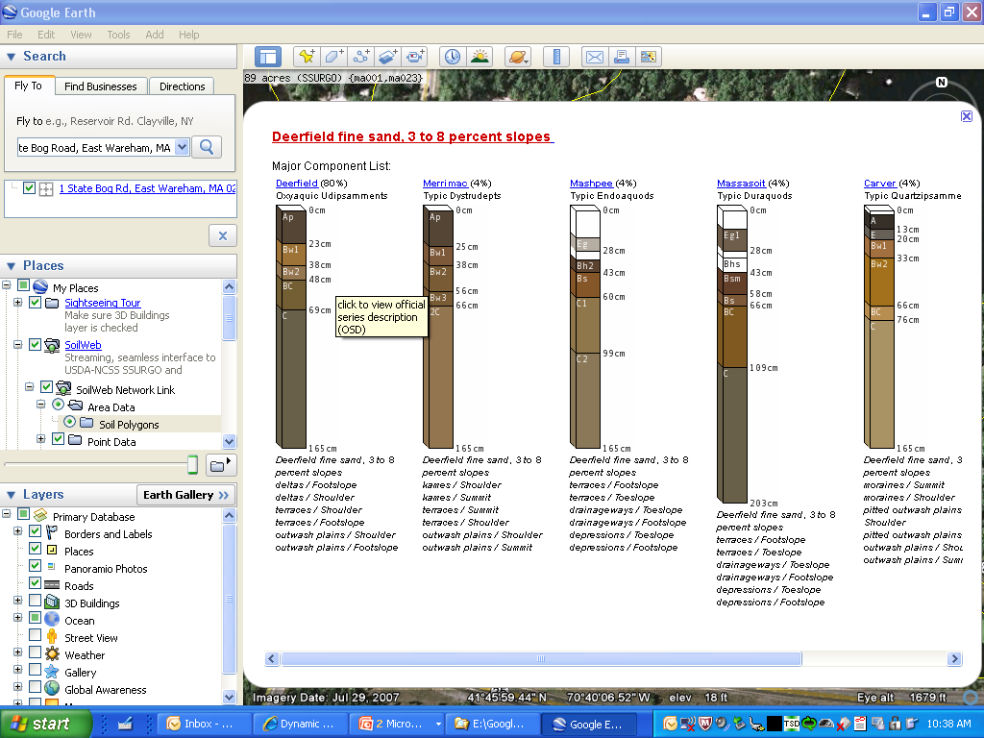
Google

Slide 26
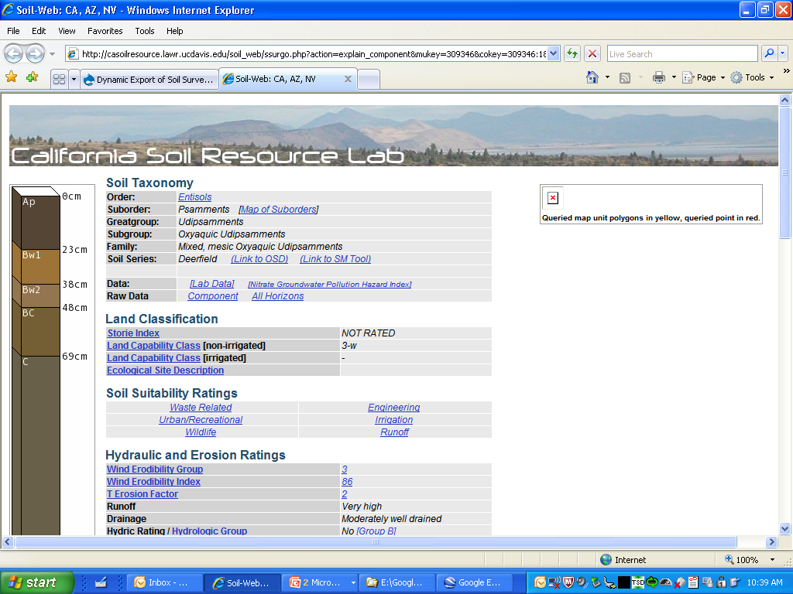
Google

Slide 27
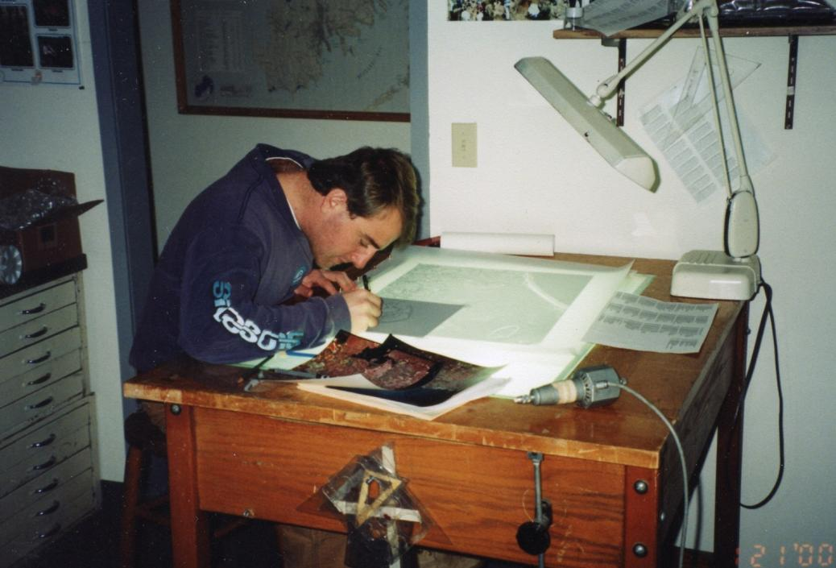
Thanks Rob!

